Slide 1

Design and Analysis of Algorithms
Dinesh Singh
Department of Computer Science & Engineering

Slide 2
DESIGN AND ANALYSIS OF ALGORITHMS
Greedy Technique
Dinesh Singh
Department of Computer Science & Engineering

Slide 3
Design and Analysis of Algorithms
Greedy Technique
Greedy Approach
The greedy approach suggests constructing a solution through a sequence of steps, each expanding a partially constructed solution obtained so far, until a complete solution to the problem is reached.
At each step the choice made to expand partially constructed solution must be:
feasible, i.e., it has to satisfy the problem’s constraints
locally optimal, i.e., it has to be the best local choice among all feasible choices available on that step
irrevocable, i.e., once made, it cannot be changed on subsequent steps of the algorithm

Slide 4
Design and Analysis of Algorithms
Greedy Technique
Finding a Minimum Spanning Tree
A spanning tree of an undirected connected graph is its connected acyclic sub graph (i.e., a tree) that contains all the vertices of the graph.
If such a graph has weights assigned to its edges:
A minimum spanning tree is its spanning tree of the smallest weight, where the weight of a tree is defined as the sum of the weights on all its edges.
The minimum spanning tree problem is the problem of finding a minimum spanning tree for a given weighted connected graph

Slide 5
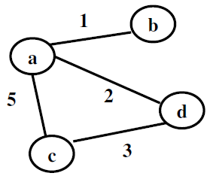
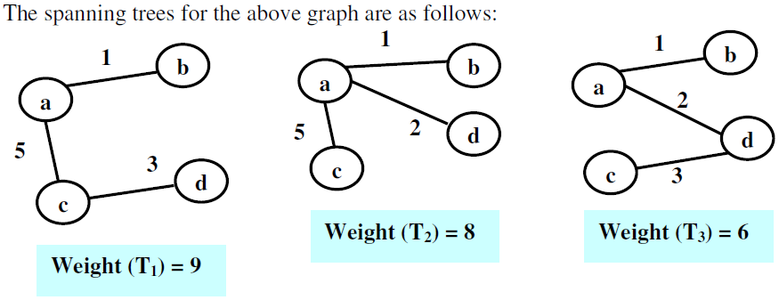
Design and Analysis of Algorithms
Greedy Technique

Slide 6
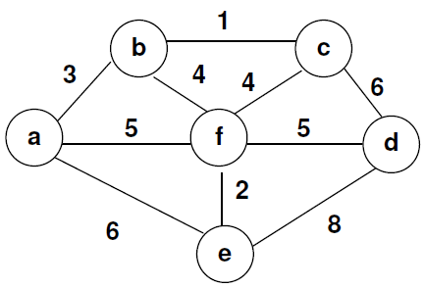
Design and Analysis of Algorithms
Greedy Technique
Find Minimum Spanning Tree of the following graph

Slide 7
Design and Analysis of Algorithms
Greedy Technique – Prims Algorithm
Prims Algorithm
Prim’s algorithm constructs a minimum spanning tree through a sequence of expanding subtrees.
The initial subtree in such a sequence consists of a single vertex selected arbitrarily from the set V of the graph’s vertices
On each iteration, the algorithm expands the current tree in the greedy manner by simply attaching to it the nearest vertex not in that tree.
The algorithm stops after all the graph’s vertices have been included in the tree being constructed. Since the algorithm expands a tree by exactly one vertex on each of its iterations, the total number of such iterations is n − 1, where n is the number of vertices in the graph

Slide 8
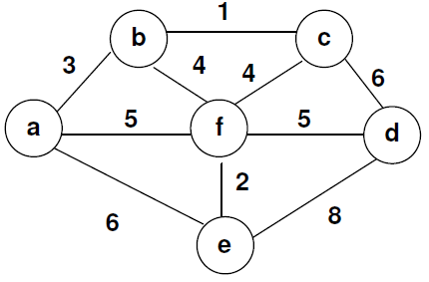
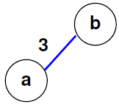
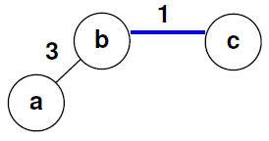
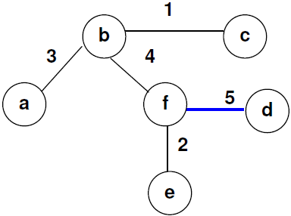
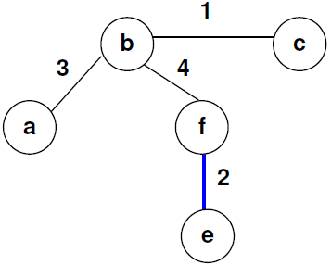
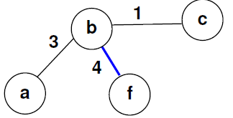
Design and Analysis of Algorithms
Greedy Technique – Prims Algorithm

Slide 9
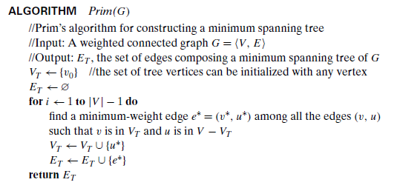
Design and Analysis of Algorithms
Greedy Technique – Prims Algorithm
Pseudo Code of Prims Algorithm

Slide 10
Design and Analysis of Algorithms
Greedy Technique – Prims Algorithm
Implementation of Prims Algorithm
Each vertex not in the current tree should have the information of its nearest tree vertex and the distance to that vertex
This is provided by attaching two labels to a vertex: the name of the nearest tree vertex and the length (the weight) of the corresponding edge.
Vertices that are not adjacent to any of the tree vertices can be given the ∞ label indicating their “infinite” distance to the tree vertices and a null label for the name of the nearest tree vertex.

Slide 11
Design and Analysis of Algorithms
Greedy Technique – Prims Algorithm
Split the vertices that are not in the tree into two sets, the “fringe” and the “unseen.” The fringe contains only the vertices that are not in the tree but are adjacent to at least one tree vertex.
The fringe vertices are the candidates from which the next tree vertex is selected.
The next vertex U* to be added to the current tree T =<V_{T}, E_{T} > is computed by selecting the vertex with the smallest distance label in the set V − V_{T} .

Slide 12
Design and Analysis of Algorithms
Greedy Technique – Prims Algorithm
After a vertex u∗ to be added to the tree is identified, Perform two operations
  Move u∗ from the set V − V_{T} to the set of tree vertices V_{T} .
  For each remaining vertex u in V − V_{T} that is connected to u∗ ,
      if the u’s distance label is greater than the distance between u and u* (d_{u} > w[u*,u] ) , Update labels of u
              1) by u∗ ( name of the nearest tree vertex) and
              2) the weight of the edge between u* and u.

Slide 13
Design and Analysis of Algorithms
Greedy Technique – Prims Algorithm
Finding Minimum Spanning Tree for the following graph

Slide 14
Design and Analysis of Algorithms
Greedy Technique – Prims Algorithm
Prim’s Algorithm:

Slide 15
Design and Analysis of Algorithms
Greedy Technique – Prims Algorithm
Prim’s Algorithm:

Slide 16
Design and Analysis of Algorithms
Greedy Technique – Prims Algorithm
Prim’s Algorithm:

Slide 17
Design and Analysis of Algorithms
Greedy Technique – Prims Algorithm
Prim’s Algorithm:

Slide 18
Design and Analysis of Algorithms
Greedy Technique – Prims Algorithm
Prim’s Algorithm:

Slide 19
Design and Analysis of Algorithms
Greedy Technique – Prims Algorithm
Efficiency of Prims Agorithm
The Efficiency depends on the data structures chosen for the graph itself and for the priority queue of the set V − V_{T} whose vertex priorities are the distances to the nearest tree vertices.
If Graph represented as a Adjacency Matrix and Priority queue implemented as an unordered array -
Extract Minimum Vertex (choose next vertex to include in MST)
  Scan the entire array to find the minimum key
  Cost per extraction = ϴ(V)
  Done V times
  Total cost= ϴ(V²)

Slide 20
Design and Analysis of Algorithms
Greedy Technique – Prims Algorithm
Update Adjacent Vertices
  Using an adjacency matrix, to find neighbors of a vertex, scan an entire row
  Cost per iteration = ϴ(V)
  Done V times
  Total cost= ϴ(V²)
Total Complexity
  ϴ(V²)+ ϴ(V²)= ϴ(V²)

Slide 21
Design and Analysis of Algorithms
Greedy Technique – Prims Algorithm
If Graph represented as a Adjacency Matrix and Priority queue implemented as a min Heap
For a graph with V vertices:
Extract minimum from heap (choose next vertex to include in MST)
  Done V times
  Each operation in a heap takes ϴ(log V)
  Total : ϴ VlogV
Update keys of adjacent vertices :
  Scan entire row of matrix → Θ(V) per iteration
  Done for V vertices, Total scanning cost: Θ(V²)
  Update happens only when key improves
  Each update costs Θ(log V) in a heap
Scanning cost dominates the overall complexity
Final Complexity: Θ(V²)

Slide 22
Design and Analysis of Algorithms
Greedy Technique – Prims Algorithm
If Graph represented as a Adjacency List and Priority queue implemented as a min Heap
Let: V = number of vertices, E = number of edges
Extract-Min Operation
  We extract one vertex at a time into MST
  Total extractions = V
  Each extract-min in heap = Θ(log V)
  Total cost = Θ(VlogV)
Update keys of adjacent vertices
  Using adjacency list, we only visit actual neighbors, each edge is examined once
  Total adjacency traversal=Θ(E)
  When a better edge is found, we update the key
  Each update of key operation = Θ(log V)
  Each edge can cause at most one improvement , Total cost=Θ(ElogV)
  Since E >V, Θ(ElogV)dominates,
  Final Complexity : Θ(ElogV)

Slide 23
Design and Analysis of Algorithms
Multiple Choice Questions
In Prim’s algorithm implemented using a min-heap and adjacency list, which of the following best explains why the complexity is Θ(Elog⁡V) ?
A. Each vertex is inserted into the heap once
B. Each edge is processed once and may cause a decrease-key operation (up
C. Heapify operation dominates the execution
D. The number of vertices is always greater than edges
Answer: B Each edge is processed once and may cause a decrease-key operation

Slide 24
Design and Analysis of Algorithms
Multiple Choice Questions
Consider Prim’s algorithm using an adjacency matrix and simple array (no heap). What is the dominant operation contributing to the total complexity?
Extract-min operation
Decrease-key operation
Scanning all vertices to find the minimum
Edge relaxation
Answer C: Scanning all vertices to find the minimum

Slide 25
Design and Analysis of Algorithms
Multiple Choice Questions
In Prim’s algorithm, why does using an adjacency matrix with a min-heap still result in Θ (V²)?
A. Heap operations are slower than array operations
B. Decrease-key is performed V² times
C. Matrix forces scanning of all vertices for each iteration
D. Extract-min becomes Θ(V)
Answer : C. Matrix forces scanning of all vertices for each iteration

Slide 26
Design and Analysis of Algorithms
Multiple Choice Questions
The term “locally optimal choice” in greedy algorithms refers to:
A. Choosing a solution that is globally optimal
B. Choosing the best option among all future possibilities
C. Choosing the best option available at the current step
D. Choosing a random feasible solution
Answer C. Choosing the best option available at the current step

Slide 27
Design and Analysis of Algorithms
Multiple Choice Questions
Which of the following scenarios would fail for a greedy approach?
When local choices always lead to global optimum
When early decisions restrict future optimal solutions
When choices are independent
When the solution is constructed incrementally
Answer B. When early decisions restrict future optimal solutions

Slide 28

THANK YOU
Dinesh Singh
Department of Computer Science & Engineering

